Slide 1
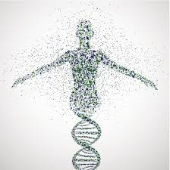
Genetics and Genomics Primer
Alicia Martin
Modified from: Elizabeth Atkinson (thanks!)
Makerere University
November 16, 2021
armartin@broadinstitute.org
Notes:
Hoping to tie together a bunch of the concepts that we have covered throughout the semester in this presentation, some review to hit concepts home and leading in to some of the cool applications for genomics and bioinformatics work in forensics and medicine

Slide 2

What are bioinformatics and genomics?
Notes:
So in this GINGER workshop over the next week, we will be delving into Bioinformatics and genomics. But what are these? And what is the difference?

Slide 3
Bioinformatics
General definition: computational techniques for solving biological problems
Data problems: storage and retrieval (databases), analysis (statistics, artificial intelligence, optimization, etc.)
Biology problems: sequence analysis, structure or function prediction, data mining, etc.
Also called computational biology

Slide 4
Genomics
“a branch of biotechnology concerned with applying the techniques of genetics and molecular biology to the genetic mapping and DNA sequencing of sets of genes or the complete genomes of selected organisms, with organizing the results in databases, and with applications of the data (as in medicine or biology)”
Notes:
Merriam Webster definition of genomics.
So most of what we will do today is more classified as genomics than bioinformatics, though we will touch on both.
Want this to be pretty casual – feel free to ask questions or make comments as we go through this introductory lecture bit.
People have different backgrounds, so sorry that this might be a review for some of you, and a lot of information quickly for others

Slide 5
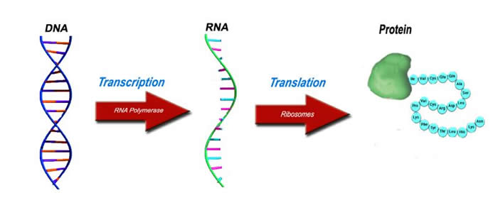
The Central Dogma
Notes:
The central dogma of molecular biology explains that DNA codes for RNA, which codes for proteins. DNA is the molecule of heredity that passes from parents to offspring. It contains the instructions for building RNA and proteins, which make up the structure of the body and carry out most of its functions.

Slide 6
DNA
Composed of small molecules called nucleotides
Four different nucleotides/bases: adenine (A), cytosine (C), guanine (G) and thymine (T)
Is a polymer: large molecule consisting of similar units (nucleotides in this case)
A single strand of DNA can be thought of as a string composed of the four letters: A, C, G, T
ctgctggaccgggtgctaggaccctga gcctgcaagtgcgagaccctctgag...
Notes:
DNA is the recipe for an organism.

Slide 7
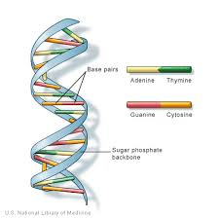
The Double Helix
DNA molecules usually consist of two strands arranged in the famous double helix
Watson-Crick base pairs:
A=T
C=G
Notes:
in double-stranded DNA A always bonds to T C always bonds to G

Slide 8
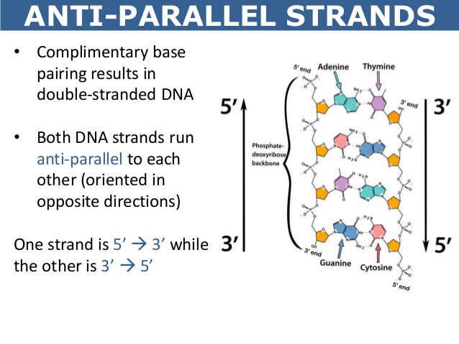
Antiparallel strands
Each strand of DNA has a “direction”
The 3' end carries a sugar group and the 5’ end carries a phosphate group.
The two complementary strands run in opposite directions - antiparallel
Notes:
The 3' and 5' notation refers to the numbering of carbon atoms in the sugar ring.
In a double helix, the strands are antiparallel (arrows drawn from the 5’ end to the 3’ end go in opposite directions)

Slide 9
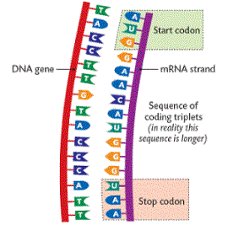
Codons
DNA read as basepair triplets – codons
The grouping of codons is called the reading frame
Translation begins with the start codon
Translation ends with the stop codon

Slide 10
The genetic code
DNA: sequence of four different nucleotides.
Proteins: sequence of twenty different amino acids.
The correspondence between DNA's four letter alphabet and a protein's twenty-letter alphabet is specified by the genetic code
Redundancy – synonymous and non-synonymous changes
Notes:
Only 4 nucleotides, but 20 amino acids! This means that there is redundancy - multiple combinations of nucleotides can result in the same amino acid sequence

Slide 11
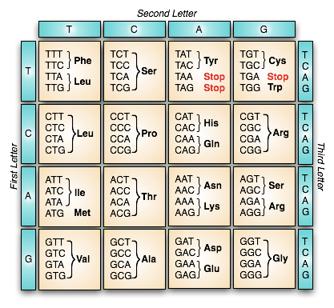
DNA to protein code
Notes:
Here is the universal code, has everyone seen a chart like this? Follow allong from left row to the column for each letter to see the options for amino acides that those two starting nucleotides can produce.
ASK : What position is the most volatile? As in, can be changed without much functional consewuence? Which is/are the most conserved?
You can use this to get a sense of how bad a mutation is; if it changes the amino acid and thus protein, it is going to be functionally different and thus can be acted on by natural selection, which is to say it could have a good or bad effect on the individual.
3rd basepair positon can change and be silent. First is a major change. Can predict functional effect of mutations based on how different a new protein from a mutation is.

Slide 12
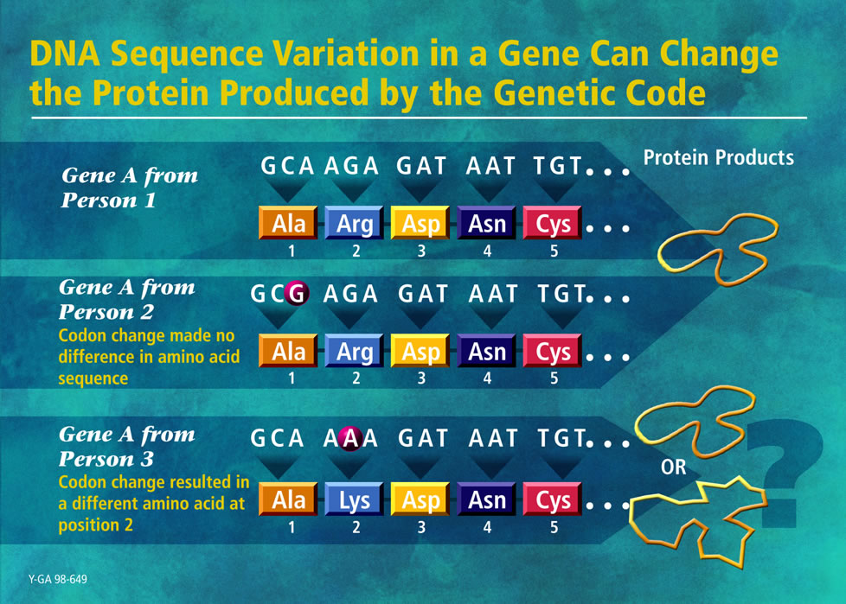
Image from the DOE Human Genome Program. http://www.ornl.gov/hgmis
Notes:
So the first change is “synonymous” – same amino acid is produced, analine. The second is non-synonymous – it changes to a lysine. A different amino acid is produced and will have a different functional effect

Slide 13
Single Nucleotide Polymorphism (SNP)
"A DNA sequence variation occurring commonly within a population (e.g. 1% frequency) in which a single nucleotide … differs between members of a biological species”
On online browsers, individual SNPs are often given a unique identifier (rsID)
Notes:
Point mutation can involve an insertion or deletion of a bp, which is the difference between that and a SNP
We will come back to SNPs in much more detail once we have finished the baisc genetics recap, but I wanted to give a preview now in the context of thinking about how not every point mutation is created equal

Slide 14
Genes
A gene is a sequence of bases that carries the information required for constructing a particular protein
Such a gene is said to encode a protein
The human genome contains ~25,000 protein-coding genes
Not all DNA in an organism encodes a protein
Less than ~2% of the human genome is coding
Notes:
Genes are the basic units of heredity

Slide 15
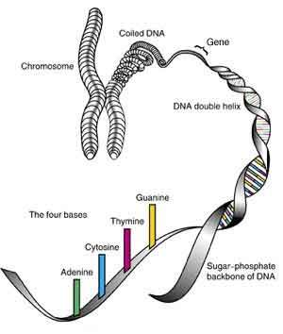
The Genome
The “genome” is the full set of DNA for a given species
The genome is distributed along chromosomes
compressed and entwined DNA
All cells with a nucleus contain the entire genome for the organism
Notes:
So here can see the whole scale of things, from the 4 basepair nucleotides, then organized into strings that form genes, which are coiled up and then assembled into chromosomes

Slide 16
Recombination
Notes:
Chromosomal crossover involves recombination between the paired chromosomes inherited from each of one's parents, generally occurring during meiosis. During prophase I (pachytene stage) the four available chromatids are in tight formation with one another. While in this formation, homologous sites on two chromatids can closely pair with one another, and may exchange genetic information

Slide 17
The human genome
The human genome is distributed along 23 pairs of chromosomes
22 autosomal pairs
1 sex chromosome pair, X and Y
In each pair, one chromosome is paternally inherited, the other maternally inherited
Mosquitos have 3
Camels have 35!
Notes:
We will spend most of the time here talking about the human genome since that’s what most folks are focused on, so will pay it special attention, but I do want to frame it in the context of comparative genomics to get a sense of the bigger picture of genoms
Genome size doesn’t equal to organism complexity for the most part

Slide 18
Genome Size
Genomes of most bacteria and archaea range from 1 to 6 million base pairs (Mb)
Genomes of eukaryotes are usually larger
Most plants and animals have genomes greater than 100 Mb
humans have 3,000 Mb
Complexity ≠ bigger genome
Notes:
Comparing bacteria, archaea, and eukaryotes shows a general progression from smaller to larger genomes.
Most bacterial genomes have between 1 and 6 million base pairs (Mb); the genome of E. coli, for instance, has 4.6 Mrgabases.
Genomes of archaea are generally within the size range of bacterial genomes.
Eukaryotic genomes are larger: The genome of the single-celled yeast S. cerevisiae (a very simple euokaryote) has about 12 Mb. Scaling up to multicellular animals and plants, most have genomes with at least 100 Mb.
Interestingly, a comparison of genome sizes among eukaryotes does not show any systematic relationship between genome size and phenotype.

Slide 19
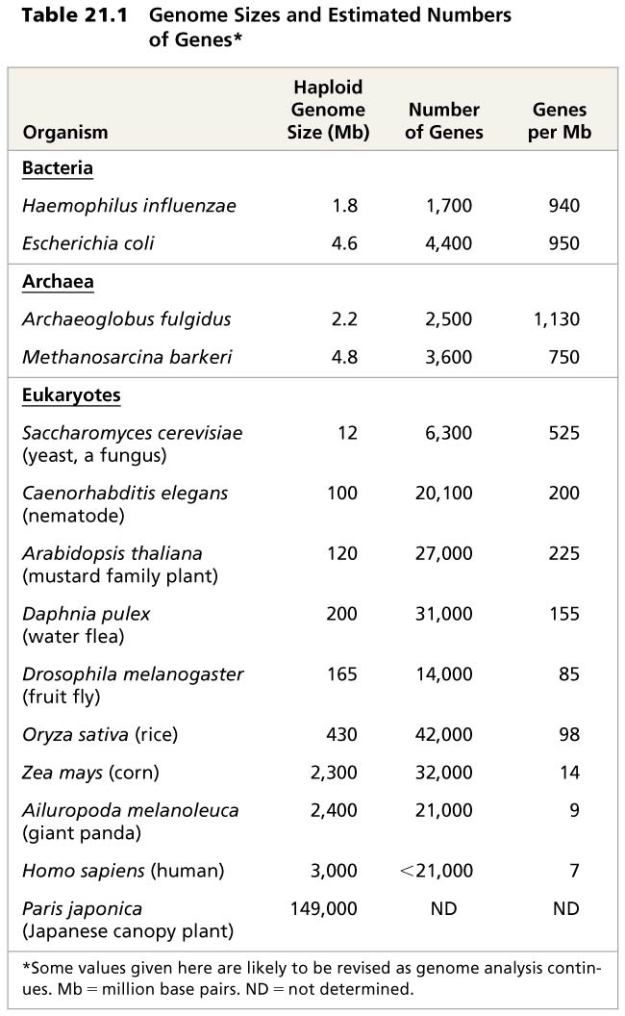
Genome sizes
Number of genes is not correlated to genome size
C. elegans has 100 Mb and 20,100 genes, Drosophila has 165 Mb and 14,000 genes
Humans only have 21,000
Notes:
Here, we can see how bacteria/archae generally do have smaller genoems than eukaryotes, but within eukraryotes, there is not a super clear relationship between genome sie and complexity. For example corn and giant pandas have nearly exactly the same genome size, which is barely less than us. And take a look at the japonese canopy plant!
So not only is genome
The genome of the nematode C. elegans has 100 Mb and contains roughly 20,000 genes.
The D. melanogaster genome is almost twice as big (165 Mb) but has about two-thirds the number of genes—only 13,700 genes.
At the outset of the Human Genome Project, biologists expected to identify between 50,000 and 100,000 genes based on the number of known human proteins.
As the project progressed, the estimate was revised downward several times, and, as of 2010, the most reliable count is fewer than 21,000.
This low number, similar to that of the nematode C. elegans, has surprised biologists.

Slide 20
Japonese canopy plant
Notes:
While pretty, doesn’t seem so especially complex as to need a genome that is 50 times larger than that of us, Homo sapiens

Slide 21
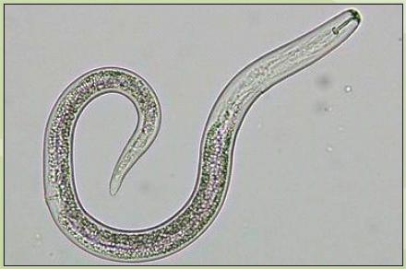
How do humans (and other vertebrates) get by with no more genes than a nematode? [1 min pair-share]
Vertebrate genomes can produce more than one polypeptide per gene because of alternative splicing of RNA transcripts!
Notes:
Alright so now let’s consider the nematode genome in the context of this question. Nematode C. elegans has the same number of genes as humans. Basically one long digestive track. So… pose question:
Humans are clearly much more organizationally complex than nematodes. Have many more cell types, complex central nervous system, etc.
How can humans get more “bang for their buck” out of their genome?
Take 1 min to think and discuss with your neighbors.

Slide 22
RNA Processing
In alternative RNA splicing, different mRNA molecules are produced from the same primary transcript, depending on which RNA segments are treated as exons and which as introns
The same DNA sequence can thus generate multiple functional proteins
Notes:
Vertebrate genomes use extensive alternative splicing of RNA transcripts.
This process generates more than one functional protein from a single gene. Multipurpose coding sequence

Slide 23
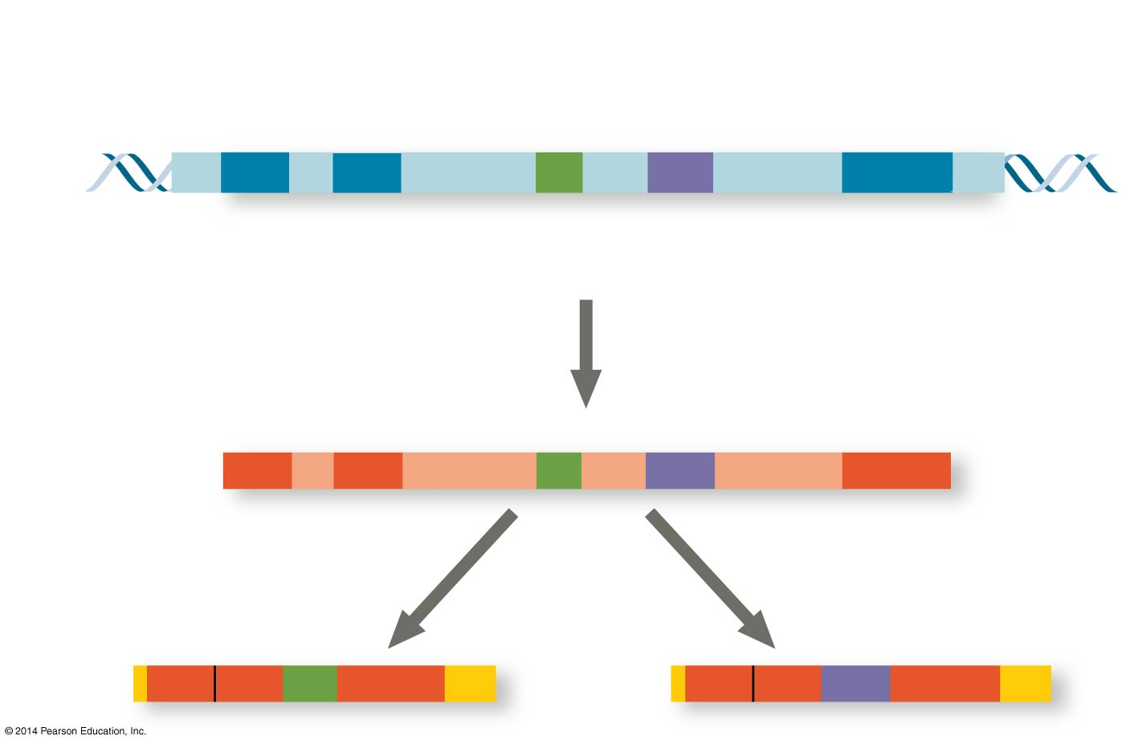
Figure 18.13
Exons
DNA
1 2 3 4 5
Troponin T gene
Primary RNA transcript
1 2 3 4 5
RNA splicing
mRNA
1 2 3 5
OR
1 2 4 5
Notes:
Alternative RNA splicing of the troponin T gene
As you likely know, exons are the coding part of the gene – what is “expressed” - and the introns are the intervening sequences that generally get cut out from the final transcript. BUT sometimes exons are cut out also to generate different final mRNA and protein products.
Go through example – same coding sequence results in proteins that can behave differently
Most human genes contain about 10 exons, and an estimated 93% of these multi-exon genes are spliced in at least two different ways.
So this means that the number of different proteins encoded in the human genome far exceeds the proposed number of genes. We get more bang for our buck!
Additional polypeptide diversity can result from post-translational modifications such as cleavage or addition of carbohydrate groups in different cell types or at different developmental stages.
The added level of regulation offered by miRNAs and other small RNAs may contribute to greater organismal complexity for a given number of genes.

Slide 24
Gene Density and Noncoding DNA
Humans and other mammals have the lowest gene density, or number of genes, in a given length of DNA
Multicellular eukaryotes have many introns within genes and a large amount of noncoding DNA between genes
Most DNA in bacterial genomes consists of genes, and lack introns
Notes:
Gene density is the number of genes present in a given length of DNA.
So getting back to this idea of comparative genomics and genome size, Generally, eukaryotes have larger genomes but lower gene density than prokaryotes.
In bacterial genomes, most of the DNA consists of coding DNA
-Nontranscribed regulatory sequences, such as promoters, make up only a small amount of the DNA.
Bacterial genes lack introns.
Most eukaryotic DNA does NOT code for protein and is not transcribed into functional RNA molecules (such as tRNAs or miRNAs).
In fact, humans have 10,000 times as much noncoding DNA as bacteria.
Some of the DNA in multicellular eukaryotes is present as introns within genes.
Introns account for most of the difference in average length between human genes (27,000 base pairs) and bacterial genes (1,000 base pairs).
In addition to introns, multicellular eukaryotes have a vast amount of non-protein coding DNA between genes.

Slide 25
Multicellular eukaryotes have lots of non-coding DNA and multigene families
Sequencing of the human genome reveals that 98.5% does not code for proteins, rRNAs, or tRNAs
About a quarter of the human genome codes for introns and gene-related regulatory sequences
Notes:
Only 1.5% of the human genome codes for proteins or produces rRNAs and tRNAs.
Gene-related regulatory sequences and introns account for, respectively 5% and 20% of the human genome.

Slide 26
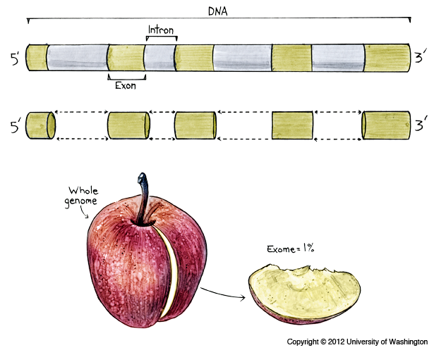
Notes:
You can think of targeting the exome as getting out just the small slice of the whole genome that is very likely to be responsible for the genetic diseases you see. It’s for this reason that many labs choose to do whole exome rather than whole genome sequencing – you can get the whole coding sequence for a patient by sequencing 2% of what you would for a whole genome – a lot cheaper to run, which means you can spend your money doing deeper sequencing, getting more reads covering each site multipe ktimes, which makes you more confident about calling the sequence.

Slide 27
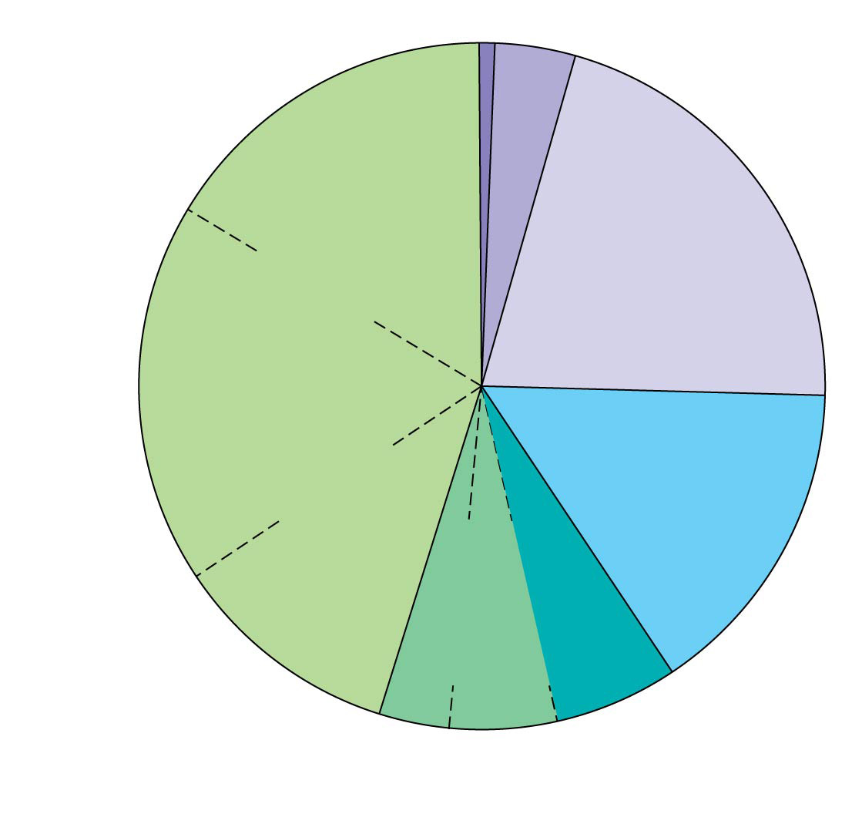
Figure 21.6
Exons (1.5%)
Regulatory sequences (5%)
Introns (∼20%)
Repetitive DNA that includes transposable elements and related sequences (44%)
Unique noncoding DNA (15%)
L1 sequences (17%)
Repetitive DNA unrelated to transposable elements (14%)
Alu elements (10%)
Simple sequence DNA (3%)
Large-segment duplications (5–6%)
Notes:
Figure 21.6 Types of DNA sequences in the human genome
Can see the breakdown of how the genome is partitioned. Exons are the tiny 1.5% at the top! Notice introns at 20%. Most of the genome is actually repetitive DNA sequenes, shown in greens. We will come back to STRs (Short Tandem Repeats) for an example to do with forensics in a momen

Slide 28
“Junk DNA” is not junk
Evidence indicates that noncoding DNA plays important roles in the cell
Structural; used in cell division
Conserved across species
Notes:
This noncoding DNA had historically been described as “junk DNA.” Far from junk, we now think this DNA plays important roles in the cell, explaining why it has persisted in diverse genomes over hundreds of generations.
Much of a genome’s simple-sequence DNA is located at chromosomal telomeres and centromeres, suggesting that this DNA plays a structural role for chromosomes.
The DNA at centromeres is essential for the separation of chromatids in cell division.
Centromeric DNA, along with simple-sequence DNA located elsewhere, may help organize the chromatin within the interphase nucleus.
The simple sequence DNA located at telomeres, at the tips of chromosomes, prevents genes from being lost as the DNA shortens with each round of replication.
Telomeric DNA binds proteins that protect the ends of a chromosome from degradation and from joining to other chromosomes.
Centromere - the region of a chromosome to which the microtubules of the spindle attach, via the kinetochore, during cell division.
For example, genomes of humans, rats, and mice show high sequence conservation for about 500 noncoding regions

Slide 29
Mutations
A mutation is a change in the base pair composition.
This means the gene will have either a base pair (or multiple base pairs) missing, added, or exchanged for a different one at a particular site.

Slide 30
How common are mutations?
Everybody has about new 6 mutations in each cell in their body.
These mutations may differ per cell even though they all have the same copy of DNA. Remember DNA is constantly replicating and cells continuously dividing.
If mutations are so common why doesn’t everyone look weird?
Remember a gene mutation may either be good, bad, or neutral!
Notes:
Every cell has its own set of DNA.
Per cell there is about 6 mutations. Doesn’t sound as terrible if you remember you have 3 billion base pairs per genome.
Also remember from what we talked about earlier – not every mutation is created equal, some have much more significant consequences than others

Slide 31
Why are mutations important for evolution?
Mutations are a source of genetic variation for a population.
Depending on if a mutation is beneficial or harmful, natural selection can either select for everyone in the population to have it or remove the mutation from the population.
Notes:
Remember a mutation occurs at random—the forces of natural selection or genetic drift decide what happens to the mutation.
Mutations are a source of genetic variation in the population. Why might this be a good thing for evolution? Because it provides more opportunities to adapt to a changing environment. Remember…adapt or go extinct!

Slide 32
How are mutations inherited?
Only mutations in the gametes (sperm and egg cells) are passed onto offspring
Mutations in body cells (autosomal cells) only affect the organism in which they occur and are not passed on to any offspring.

Slide 33
3 types of mutations
Substitution
Deletion
Insertion
Frameshift
Notes:
These last two are referred to as frameshift mutations and we will see when we do a few exercises why this is

Slide 34
Substitution mutation: a single base is substituted for a different base
Normal DNA | CGA – TGC – ATC
 | Alanine - Threonine - stop
Mutated DNA | CGA – TGC – TTC
 | Alanine - Threonine - Lysine
It may or may not affect the amino acid or protein.
Notes:
Silly simple activity to get across the idea that not all mutations are created equal – some can have severe consequences while others have no impact
This can be a little tedious and I’m sure we are all tired by now, so we will use an example with pictures of cute kittens throughout to keep everyone awake and interested
So let’s start with a substitution – one basepair is swapped out

Slide 35
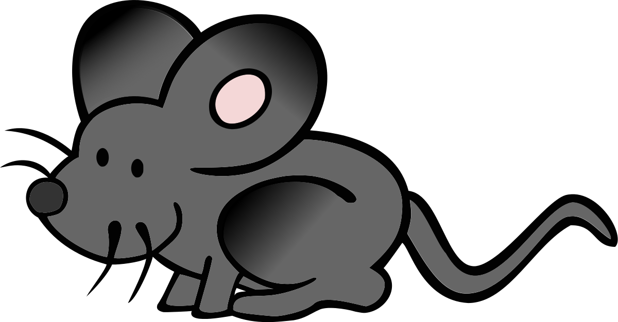
Let’s see what happens!
THE CAT ATE THE RAT
Change one letter in the sentence to represent a substitution.
THC CAT ATE THE RAT
May have a little effect. You see that there is a typo but you can still read and understand the sentence.
THE CAT ATE THE HAT
Comprehensible but now the sentence has a different meaning.
Notes:
If we think about this in the context of a sentence we can get a sense for the impact of such a mutation
Write the following sentence on the piece of paper. Then make a substitution mutaion in the sentence
Also notice that (in this example) the mutation at the end of the codon was less disruptive than the one

Slide 36
Insertion mutation: a base (or bases) is/are inserted into the sequence
It causes the frame to shift among triplets. It always affects the amino acid and consequently the protein.
Normal DNA | CGA – TGC – ATC
 | Alanine - Threonine - stop
Mutated DNA | CGA – TAG – CAT – C
 | Alanine - Leucine - Valine

Slide 37
Let’s see what happens!
THE CAT ATE THE RAT
Insert a letter into any word. Rewrite the sentence so each word has three letters.
THE CCA TAT ETH ERA T
Inserting the C causes the frame to shift and the sentence no longer makes any sense!
Notes:
If we think about this in the context of a sentence we can get a sense for the impact of such a mutation
Write the following sentence on the piece of paper. Then make a substitution mutaion in the sentence
Also notice that (in this example) the mutation at the end of the codon was less disruptive than the one

Slide 38
Deletion mutation: a base (or bases) is/are deleted from the sequence
It causes the frame to shift among triplets. It always affects the amino acid and consequently the protein.
Normal DNA | CGA – TGC – ATC
 | Alanine - Threonine - stop
Mutated DNA | CGA – TCA – TC
 | Alanine - Serine

Slide 39
Let’s see what happens!
THE CAT ATE THE RAT
Delete a letter from any word. Rewrite the sentence so each word has three letters.
THE CTA TET HER AT
Deleting the A causes the frame to shift and the sentence no longer makes any sense!
Notes:
If we think about this in the context of a sentence we can get a sense for the impact of such a mutation
Write the following sentence on the piece of paper. Then make a substitution mutaion in the sentence
Also notice that (in this example) the mutation at the end of the codon was less disruptive than the one

Slide 40
Single Nucleotide Polymorphisms (SNPs)
SNPs are single-nucleotide substitutions of one base for another that occur in more than 1% of the general population
Among the most useful genetic markers
In humans, researchers analyze the genomes of many people with a certain genetic condition to try to find nucleotide changes specific to the condition
These genome-wide association studies (GWAS) test for associations of traits with genetic markers, like SNPs
Notes:
SNPs are among the most common genetic variant used in research. So, we will spend a little bit of time talking about them and SNP arrays, which are the genotyping arrays commonly used to survey them.
A few million SNPs occur in the human genome, on average about once in 100 to 300 base pairs of both coding and noncoding DNA sequences.
Alicia will talk a lot more about GWAS in the near future, but here’s a hint at it now…

Slide 41
SNPs
SNP variants are sometimes associated with a particular inherited disorder
These alert researchers to the likely approximate location for the disease-causing gene
SNPs are rarely directly involved in the disease; they are most often in noncoding regions of the genome
Notes:
Once a region is found that has a SNP shared among affected but not unaffected people, researchers sequence or otherwise investigate more deeply that region.
In most cases, the SNP itself does not contribute to the disease. In fact, most SNPs are in noncoding regions.
If the SNP and a disease-causing allele are close enough, crossing over between the marker and the gene is very unlikely during gamete formation.
Therefore, the marker and gene will almost always be inherited together, even though the marker is not part of the gene.
SNPs have been found that correlate with diabetes, heart disease, and several types of cancer.
The search is on for genes that might be involved.

Slide 42
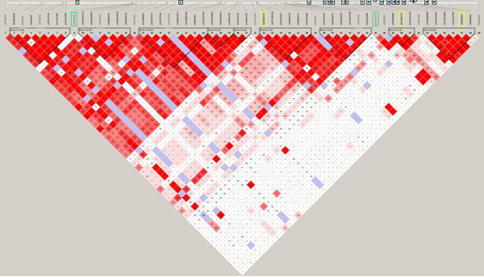
Linkage disequilibrium (LD)
“the non-random association of alleles at different loci”
Loci are more correlated with each other than you would expect by chance
Due to patterns of recombination across the genome, genetic linkage, and other factors (selection, genetic drift, population structure…)
Notes:
Heatmap showing recombination pattern across a set of a couple dozen genetic markers. Red means high correlation, white low. See blocks of high linkage, recombination hotspots. There are hotspots in recombination. Not actually evenly distributed, as had originally been thought. So there are areas that are most tightly correlated than others
Red indicates linkage blocks – highly correlated regions of the genome. Shows the pairwise comparison between all SNPs in this region.

Slide 43
LD and SNP arrays
r²
Equilibrium -
0
Conceptual understanding of LD led to the development of “tag SNPs” where a given polymorphism would tag a whole stretch of DNA (i.e., the tag SNP was in high LD with other variants nearby).
This made it possible design SNP arrays where you need only have 500,000 – 2 million SNPs to capture information at common variants across the WHOLE genome.
Major motivation for “genome-wide association studies” from SNP arrays
Intermediate correlation -
0.5
Complete disequilibrium -
1
Notes:
So because of linkage, we actually only need to sequence a smaller number of spots across the genome to get a sense of what the surrounding DNA holds. These regions are either invariable, or tightly linked to the tag SNP, so we can predict well what the sequence will hold.
So can predict DNA sequence across the whole genome based on sequencing on a small subset of the total number of sites thanks to the concept of linkage
Most GWAS studies these days involve SNP arrays

Slide 44
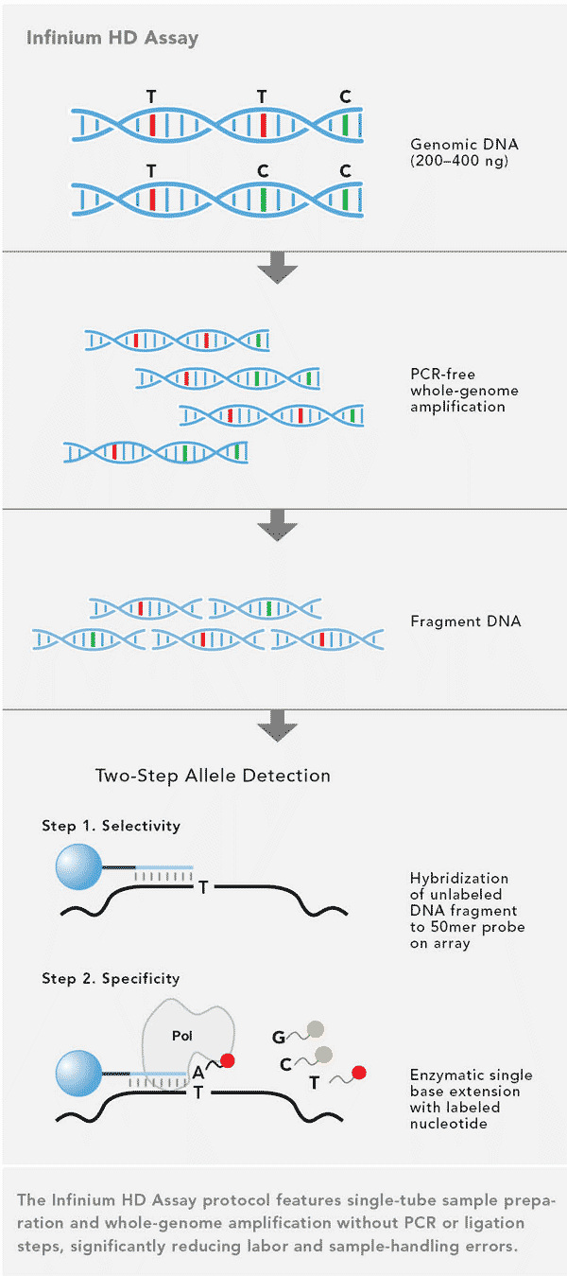
SNP Arrays
Most common data type in large-scale human genetic studies over the past ~decade
Fast to type, relatively cheap, high quality data, abundant reference panels
Assay between 100K – 5M SNPs per array
Low error rates
But… cannot find new mutations with arrays. Only known SNPs
Notes:
Vast majority of the ‘genome-wide’ datasets these days are from SNP arrays. Will take years for NGS to catch up. SNP arrays started to be commonly used around 2005 after another human genoem project, this time for a collection of DNA sequencse, HapMap was initiated.
ASK: What’s one drawback for using SNP arrays?

Slide 45
Uses of SNPs: Diagnosis and Treatment of Diseases
Scientists can diagnose many human genetic disorders using PCR and sequence-specific primers, then sequencing the amplified product to look for the disease-causing mutation
SNPs may be associated with a disease-causing mutation
SNPs may also be correlated with increased risks for conditions, such as heart disease or certain types of cancer
Notes:
Now to briefly discuss some applications of SNP arrays and other DNA sequencing technology. Modern biotechnology is making enormous contributions both to the diagnosis of diseases and in the development of pharmaceutical products.
The identification of genes whose mutations are responsible for genetic diseases may lead to ways to diagnose, treat, or even prevent these conditions.
Companies that offer individual genetic testing for health risk factors look for the presence of previously identified, linked SNPs. So if youv’e done 23 and me, or ancestry.om, they ran your genome through a SNP array to calculate your percent ancestry (discuss next) and give you estimates for risk for diseases.
Such genetic tests reflect correlations and do not make predictions.

Slide 46
Continental Ancestry
Li et al. (2008, Science)
Notes:
Just to hit on another cool application from looking at SNP-based genetic variation:
Also can gauge your percent ancestry based on the SNPs in an array.
Beak down ADMIXTURE plot – each column is an individual, sorted by their populations, each color represents a type of global ancestry. Can get the proportion of the genome of each individual here that was contributed from different global populations. The program is agnostic to what populations the individuals came from, however.
Which population looks to be the most ADMIXED? What are their ancestry components?

Slide 47
Genes mirror geography (within continents)
Novembre et al. (2008, Nature)
Notes:
Another example – sorting people by their genetic similarity to other people ends up mapping pretty well to the actual map! Here’s what the genetic map of europe looks like parsed out by Principle Components Analysis – PCA.
Can use PCs such as this to correct for issues related to population structure in your data

Slide 48
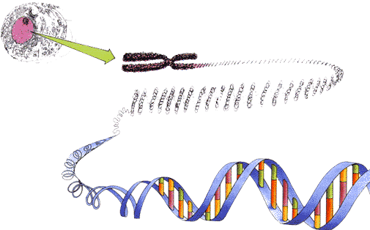
Other types of genetic variation and their uses - DNA Profiling
DNA profiling is a method of identifying an individual by unique characteristics of that person’s DNA
Also called “DNA fingerprinting”
Utility in action: STRS for solving a crime
Notes:
Optional – other kinds of genetic variation, especially in forensics
There are unique variants in each of our DNA sequences that can identify us specifically, like fingerprints
Now we will go through the sort of historical timeline in using DNA variablility to answer questions related to the uniqueness of different people. We will start with the historical perspective, looking at short tandem repeats to get across some of the concepts of how DNA variability can identify you

Slide 49
What is Analyzed in the DNA?
DNA profiling depends on regions of non-coding DNA that show great variability between individuals (are polymorphic which means many forms)
Forensic profiling uses Short Tandem Repeats, STRs
These are short sequences of DNA, usually 2-5 base pairs (bp) long, that repeat, or ‘stutter’ many times

Slide 50
Short Tandem Repeats (STRs)
AATG
7 repeats
8 repeats
the repeat region is variable between samples while the flanking regions where PCR primers bind are constant
Homozygote = both alleles are the same length
Heterozygote = alleles differ and can be resolved from one another

Slide 51
An Example of a STR in locus D7S280
D7S280 is a region (locus) of human chromosome 7. Its DNA sequence, as obtained from GenBank (a public DNA database) is:
1 aatttttgta ttttttttag agacggggtt tcaccatgtt ggtcaggctg actatggagt
61 tattttaagg ttaatatata taaagggtat gatagaacac ttgtcatagt ttagaacgaa
121 ctaacgatag atagatagat agatagatag atagatagat agatagatag atagacagat
181 tgatagtttt tttttatctc actaaatagt ctatagtaaa catttaatta ccaatatttg
241 gtgcaattct gtcaatgagg ataaatgtgg aatcgttata attcttaaga atatatattc
301 cctctgagtt tttgatacct cagattttaa ggcc
The STR repeat sequence is gata
Different alleles of this locus have from 6 to 15 tandem repeats of the ‘gata’ sequence
Notes:
Who can say what sequence is repeated?

Slide 52
Forensic Evidence and Genetic Profiles
An individual’s unique DNA sequence, or genetic profile, can be obtained by analysis of tissue or body fluids
DNA testing can identify individuals with a high degree of certainty
Genetic profiles for forensics are currently analyzed using genetic markers called short tandem repeats (STRs)
Notes:
Body fluids or small pieces of tissue may be left at the scene of a violent crime or on the clothes of the victim or assailant
Unlike eye witness testimony –which has now been shown to be extremely unreliable- DNA testing can identify the guilty individual with a high degree of certainty because the DNA sequence of every person is unique (except for identical twins).
Genetic markers that vary in the population can be analyzed for a given person to determine that individual’s unique set of genetic markers, or genetic profile.
Today, in place of RFLPs, which were what were used originally, forensic scientists and the FBI usually use an even more sensitive method, which takes advantage of short tandem repeats (STRs).

Slide 53
Forensic Evidence and STRs
STRs are variations in the number of repeats of specific DNA sequences
PCR and gel electrophoresis are used to amplify and then identify STRs of different lengths
The probability that two people who are not identical twins have the same STR markers is exceptionally small
As of 2013 more than 300 innocent people had been released from prison as a result of STR analysis of old DNA evidence
Notes:
The number of repeats present in these regions is highly polymorphic, varying from person to person and, for one individual, in the two alleles of an STR.
PCR is used to amplify particular STRs, using sets of primers that are labeled with different colored fluorescent tag. Then, the length of the region, and thus the number of repeats, can then be determined by electrophoresis. (like you did in your lab)
The PCR step allows the method to be used even when the DNA is in poor condition or available in only minute quantities. - A tissue sample containing as few as 20 cells can be sufficient for PCR amplification.
In a murder case, for example, this method can be used to compare DNA samples from the suspect, the victim, and a small amount of blood found at the crime scene.
Forensic scientists test only a few selected portions of the DNA—about 13 STR markers.
The probability that two people who are not identical twins would have exactly the same set of STR markers is vanishingly small.

Slide 54
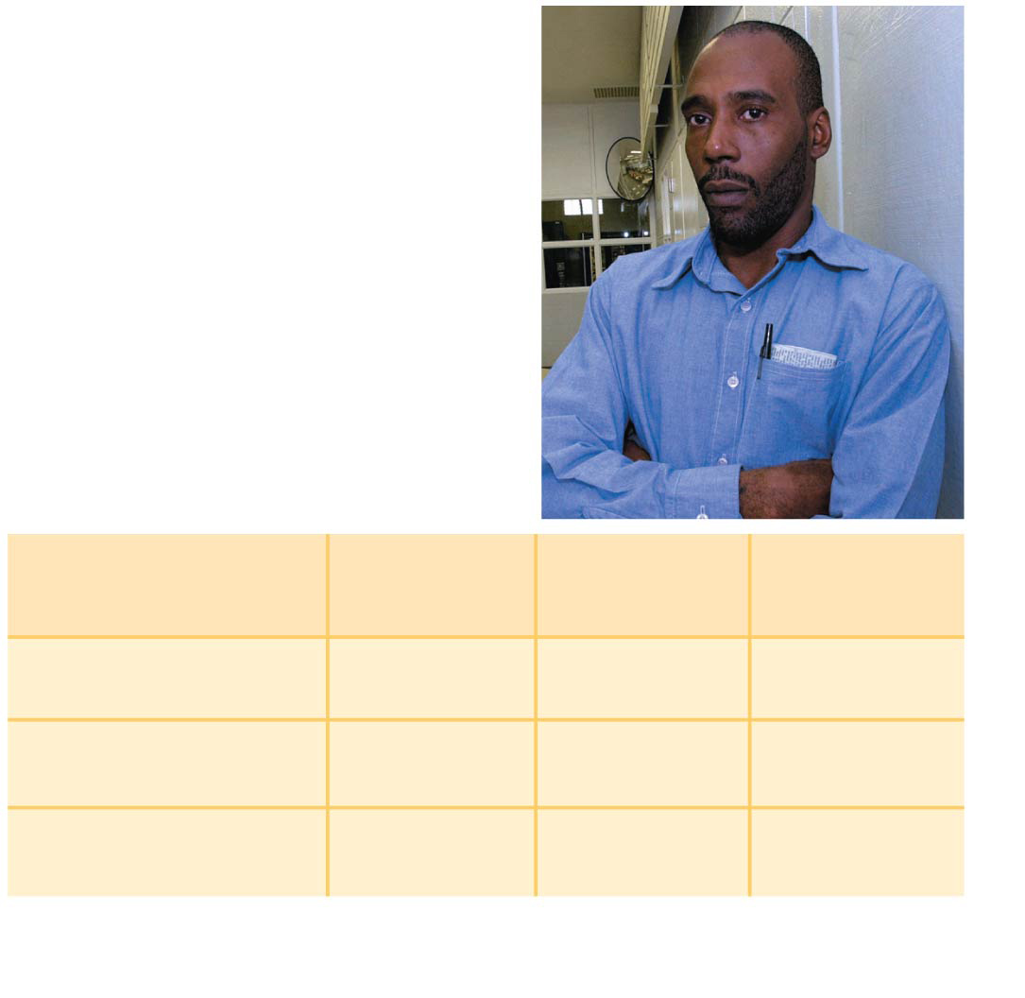
Figure 20.24
(a) Earl Washington just before his release in 2001, after 17 years in prison.
Source of sample
STR marker 1
STR marker 2
STR marker 3
Semen on victim 17,19 13,16 12,12
Earl Washington 16,18 14,15 11,12
Kenneth Tinsley 17,19 13,16 12,12
(b) These and other STR data (not shown) exonerated Washington and led Tinsley to plead guilty to the murder.
Notes:
Figure 20.24 STR analysis used to release an innocent man from prison
For example, one individual may have the sequence ACAT repeated 17 times at one genome locus and 19 times at the same locus on the other homolog, whereas another individual may have 16 and 18 repeats at this locus on each homologs, as is shown in the table.
Just how reliable is a genetic profile?
The greater the number of markers examined in a DNA sample, the more likely it is that the profile is unique to one individual.
In forensic cases using STR analysis with 13 markers, the probability of two people having identical DNA profiles is somewhere between one chance in 10 billion and one in several trillion. The exact probability depends on the frequency of those markers in the general population.
The Innocence Project, a nonprofit organization dedicated to overturning wrongful convictions, uses STR analysis of archived samples from crime scenes to revisit old cases. As of 2010, 250 innocent people had been released from prison as a result of forensic and legal work by this group.
As an aside, if you listen to the podcast Serial, this is the group that is currently tryign to investigate Adnan Syed to potentially prove his innocence.

Slide 55
Some uses of STR DNA Profiling
Forensic work on crime scenes
Parentage testing (explored in more detail)
Victim identification in mass disasters
Animal identification- e.g. racehorses
Conservation biology and evolutionary studies
Notes:
Racehorses to make sure tey are truly from the pedigree that they are claiming. We will do a parentage analysis momentarily which will teach you this concept.

Slide 56
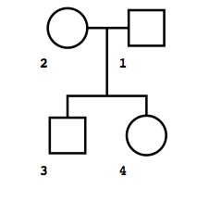
STR Activity – Paternity Test
Kate and David are twins. Their mom says their dad could be any of 3 men:
Maury, Phil, or Jerry.
MOM
DAD
DAVID
KATE
Notes:
Here’s an example of a simple pedigree. It shows the parents, connected by a line, with their children shown below. Females are drawn as circles, males as squares.
David and Kate are twins. Mom isn’t sure who dad is, but has three possible options. You will use 3 STR loci to determine which of the possible men is David and Kate’s father.
Give them up to 5 min to figure out which of the 3 possible dads is the biological father of David and Katie.

Slide 57
STR genotypes
Locus | David | Kate | Mom | Maury | Phil | Jerry
vWA | 16,16 | 16,16 | 16,16 | 16,18 | 14,16 | 16,16
FGA | 19,21 | 21,24 | 21,22 | 19,21 | 24,25 | 19,24
D3S1358 | 15,17 | 17,18 | 15,17 | 18,18 | 15,15 | 15,18
Use the STR genotypes to determine who is the father of David and Kate?
[2 min activity]
Notes:
Give up to 5 min.
Then ask who wants to suggest who it might be?
Answer is Jerry.

Slide 58
Follow-up from activity
What was more useful for getting a sense of someone’s DNA fingerprint – common variants or rare variants?
Since there can be new mutations in the child, having more sites increases your confidence
Most tests look at 13 sites, which can give you over 99.9% confidence in the determination

Slide 59
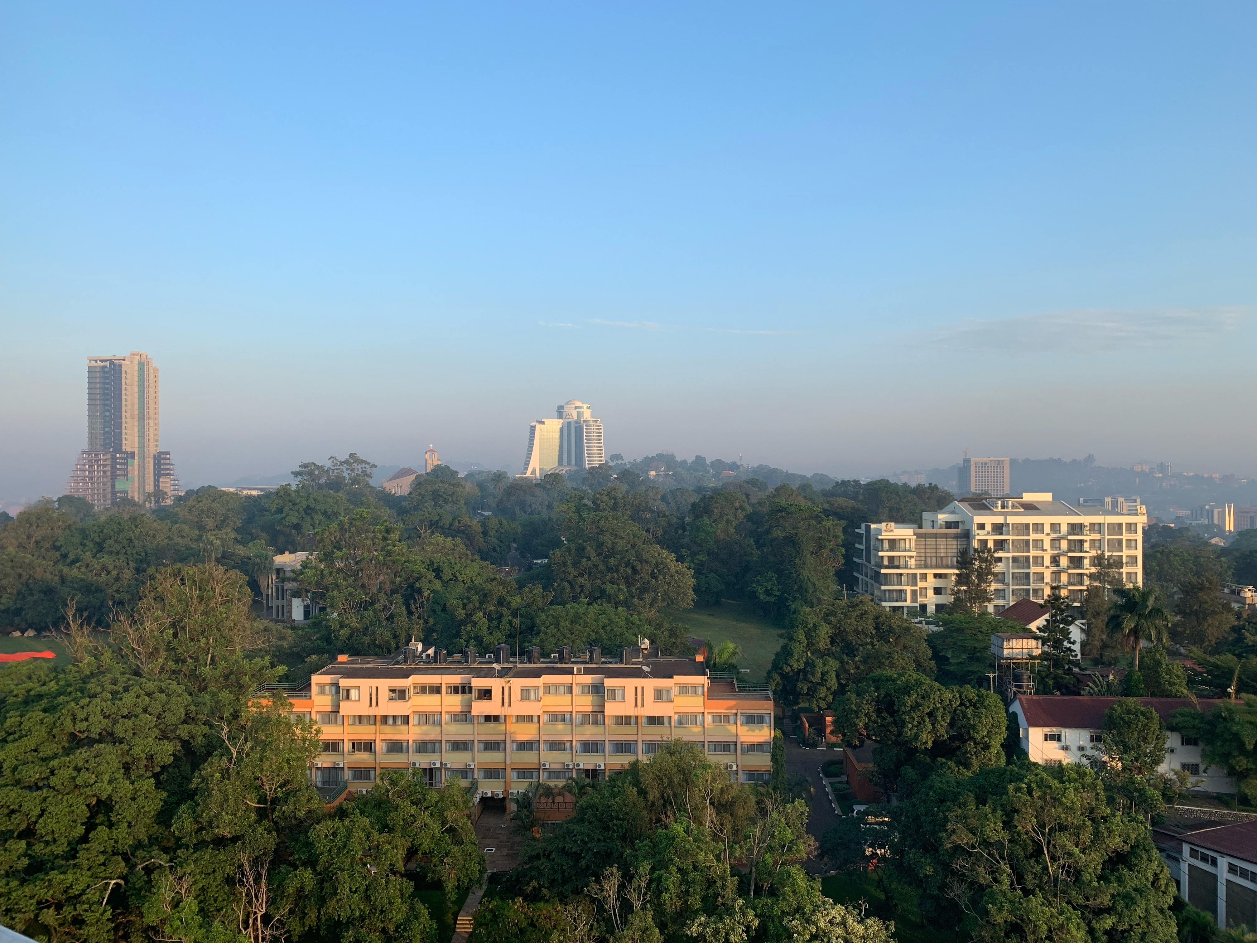
Thanks for participating!

